Slide 1
The Chelsfield Preschool and Nursery Newsletter November 2022
Firstly we wish everyone ‘Happy Diwali’. We hope you enjoyed your celebrations. The children celebrated by singing, creating Rangoli patterns using coloured rice and listening to the story of Diwali.
Dates to remember
Preschool Children return Monday 31st October. End of term for all children Friday 16th December 2022. All children return Tuesday 3rd January 2023.
Please also be aware of dates coming up. Pyjama fun day on Wednesday 2nd November. Please send the children in their favourite Pjs / Onsie, this day is for a charity called Crackerjacks Children's Trust. We would appreciate any donation you can spare we are asking for £1 donation. All monies raised will help to supply specialist disabled equipment. Please see the posters for further information.
16th November – Little Urchins will be coming to the preschool to photograph the children. Please be aware siblings are welcome to come along. Please speak to a member of the team if you wish to bring them along.
Children In Need will be Friday 18th November. Julie and Gary are due back 4th Nov we will discuss all ideas when they return. A possible idea is a coffee morning or Cake sale. We welcome any suggestions and will confirm via email and posters
Learning Themes
Our Learning theme for November will be – Past and Present. We are also celebrating Bonfire Night (5th), Remembrance day (11th) Nursery Rhyme week (14-18th) and St Andrews Day (30th). Please see our notice board for our learning for the month and daily activities.
Tips for Home learning linked to the theme. Look at Past and Present family photos to observe the change over time. Talk about home routines using time language.
Gentle Reminders
Please remember to ring the setting before 9am if your child will be arriving late to Nursery. If you have not already, please can you email through your family photo for our community wall. The children spend a lot of time talking to their peers about who lives at home, this is important in further developing their social and emotional skills.
We will update all parents regarding our Parents evening and dates for the Christmas party when Julie and Gary return.
Thank you for your continuous support and always remember we are here if you need any advice, a catch up or further support you feel you may need, we are here to help.
The Chelsfield Team
Email: chelsfieldbrom@yahoo.co.uk
Phone:
01689 853183
Website: www.thechelsfieldpre-school.com

Slide 2
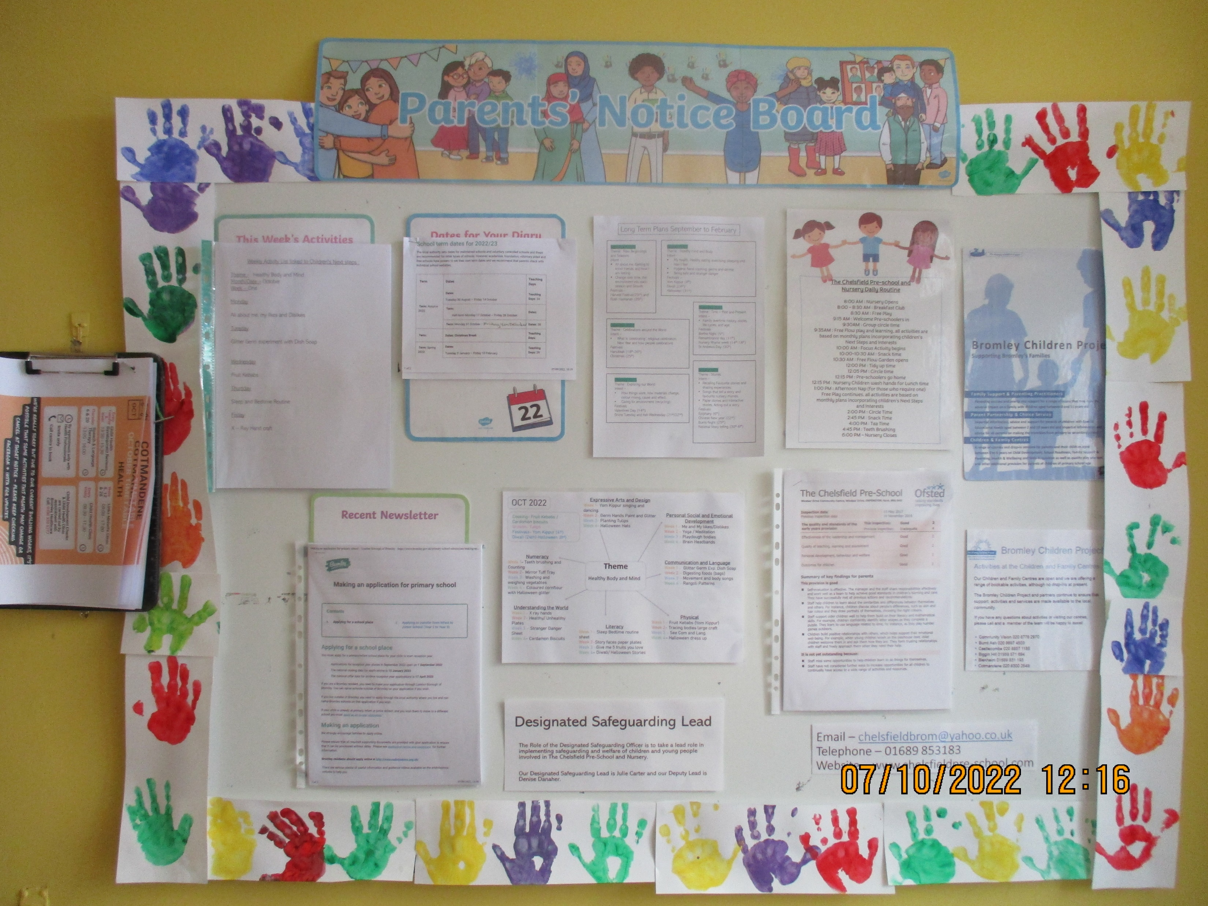
The Chelsfield Preschool and Nursery Newsletter November 2022
Further Information about the services they provide are available on our parent Board or alternatively you can speak to a member of the team.
The Bromley Children's Project
Blenheim Children and Family Centre
Email – BLENHEIMCFC@BROMLEY.GOV.UK
Phone – 01689 831193
Cotmandene Family Centre
Email – COTMANDENECFC@BROMLEY.GOV.UK
Phone – 0208 300 2548
The Bromley Children's Project
The Bromley Children's Project
Phone: 01689 853183
Email: chelsfieldbrom@yahoo.co.uk
Website: www.thechelsfieldpre-school.com

