Slide 1
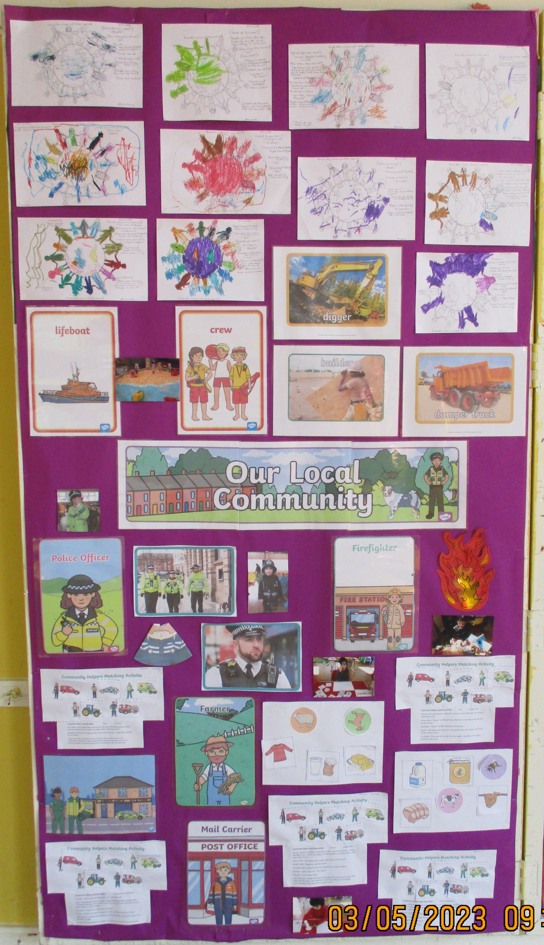
The Chelsfield Preschool and Nursery Newsletter May 2023
May themes and Celebrations
‘Our Solar System’ is May Theme. To help support learning, talk about planets, methods of travel. We will be focusing on mathematical language prepositions and size. We will be celebrating Vesak and walk to school week. The children will be making moon pizzas and biscuits for the Coronation. On Thursday 4th May the children will be having a Coronation tea party in the morning with dancing and games. For our growing this month we will be planting tomatoes.
Parent Questionnaire
Thank you to everybody who completed our Parent questionnaire. As a result of your suggestions, we are currently in the process of putting the following in place; Monthly newsletter being emailed to all parents (paper copies will still be available in the lobby and on the parent board). A parent suggestion box will be in the Lobby, please feel free to place any suggestion you have in the box. We are looking into displaying the children's photographs to enable you to see them in action and looking at how we can hold further dates to enable parents to view their learning journals more frequently. Please bear with us while we make these changes.
Term Dates
New Term starts – Monday 17th April – Friday 26th May
Bank Holidays (Nursery closed) May 1st, 8th and 29th
New Term starts - Monday 5th June – Friday 21st July
Gentle reminders
Please do not park in the carpark after 9am
Please ensure all children have a water bottle and spare clothing in their bags every day. This includes wipes and nappies if this is applicable.
Outfits ; Just a reminder no dresses are to be worn to nursery as this is not suitable for climbing in the garden.
Email: chelsfieldbrom@yahoo.co.uk
Some of our activities explored throughout last months theme ‘Our community’.
Phone: 01689 853183

Slide 2
The Chelsfield Preschool and Nursery Newsletter May 2023
Local Family Centres
Blenheim Children and Family Centre
Email –BLENHEIMCFC@BROMLEY.GOV.UK
Phone – 01689 831193
Cotmandene Family Centre
Email – COTMANDENECFC@BROMLEY.GOV.UK
Phone – 0208 300 2548
Children and Family Centres offer a range of services to meet the needs of children under five and support their families.
The Bromley Children Project and partners continue to ensure that support, activities and services are made available to the local community.
Social media: for up-to-date information, announcements and much more please visit our social media pages.
Facebook The Bromley Children Project - Facebook
Instagram The Bromley Children Project – Instagram
Youtube The Bromley Children Project - Creative Kids
Mental Health Support
NHS - 111
Samaritans - 116 123
Mind - www.mind.org.uk
Self-Help Ideas
Maintain a Healthy diet
Exercise regularly
Connect with others
Set goals and challenges
Take up a Hobby
Volunteer in the Community
Avoid unhealthy habits

