Slide 1
The Chelsfield Preschool and Nursery Newsletter October 2024
Dates For October 2024
Half Term for Pre-Schoolers : 21st -25th October
New Term begins : Monday 28th October
Nursery closed for all children Monday 23rd December
Please be aware we will return for Nursery children on Thursday 2nd January 2025. This has recently been amended as previously stated in the September Newsletter.
Pre-school children return Monday 6th January 2025
We will be holding a Parents Evening on Thursday 7th November from 5-7p.m. Please come along, view your child’s Journal and have a chat with your child’s Keyperson, where you will be able to discuss next steps. If you are unable to attend on this date, please arrange an alternative date with a member of the team.
Our theme for October is- Our Bodies
We will be looking at-
Body actions
Emotions
Inside and outside our bodies
Health
We will be celebrating Rosh Hashanah, Yom Kippur, Harvest festival, Halloween, Black history month and world space week.
Cooking for October will be Honey biscuits for Rosh Hashanah and strawberry and chocolate ghosts for Halloween.
The children will be planting Onions and Potatoes and participating in our Fizzy emotions experiment so a very busy October ahead.
Gentle Reminders
Please can parents ensure all children have a Winter coat each day.
If your child has a packed lunch, please provide an icepack inside their lunch bag to ensure their lunches remain chilled/Thermos flasks to ensure hot foods remains at the correct temperature.
Please inform via email if new people are collecting your child , with their names and a password for them to give.
Carpark
Please remember children are not to play in the carpark and no entry remains between 9am and 3pm. Please be mindful of speed when entering and exiting. Children should not be left in cars unattended .
When leaving the premises whether walking, cycling, scooting or on foot ensure you have your child close by and be vigilant when crossing the road.
Unfortunately, we have seen an increase in speed of cars driving along Windsor Drive.
Family photo
Please Email in your family photo if this is still outstanding.
We will be looking at Healthy eating and suggesting healthy options for a packed lunch. It is also very important that any foods brought from home are stored correctly and cut safely. If you require any assistance, please have a chat with Kimmie our Chef. We work tirelessly to ensure all dietary requirements are adhered to and we continue to uphold our very high standards in this area.
We will be moving over to our Winter menu as of 1st October, please find attached alongside healthy recommendations for a healthy lunch box. We hope you will find these helpful when planning your child’s food each day.
We would greatly welcome any donations for our free choice craft trolley – paper , stickers , wool etc.
You can contact us on; Phone- 01689853183
Email- Chelsfieldbrom@yahoo.co.uk

Slide 2
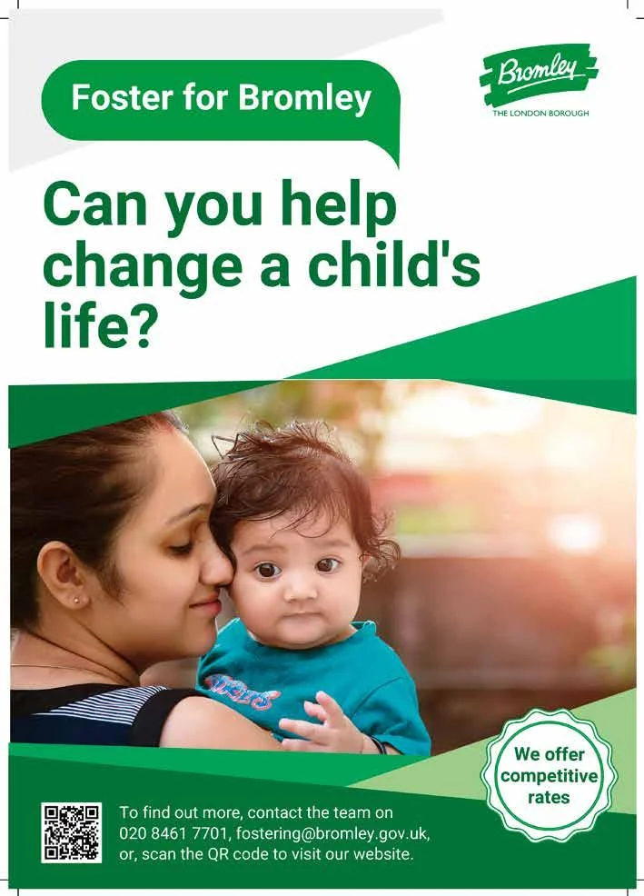
The Chelsfield Preschool and Nursery Newsletter October 2024
You can contact us on; Phone- 01689853183
Email- Chelsfieldbrom@yahoo.co.uk
NSPCC Helpline
Phone: 0808 800 500
Email: help@nspcc.org,uk
National Domestic Abuse Helpline
Phone: 0808 2000 247
Website: www.nationaldahelpline.org.uk
Bromley and Croydon Women’s Aid (BCWA)
Phone: 020 8313 9303
Email: info@bcwa.org.uk
Website: www.bcwa.org.uk
Bromley Fostering Team
Phone: 020 8461 7701
Email: fostering@bromley.gov.uk
IASS Bromley
Phone: 020 8461 7630
Email: iass@bromley.gov.uk
Local Family Centres
Blenheim Children and Family Centre
Email –BLENHEIMCFC@BROMLEY.GOV.UK
Phone – 01689 831193
Cotmandene Family Centre
Email – COTMANDENECFC@BROMLEY.GOV.UK
Phone – 0208 300 2548
Children and Family Centres offer a range of services to meet the needs of children under five and support their families.

