Slide 1



Getting to know me
Special things I need
(Dietary requirements/ Health Care Plan)
Picture
Name –
Things I like
Things I do not like

Slide 2
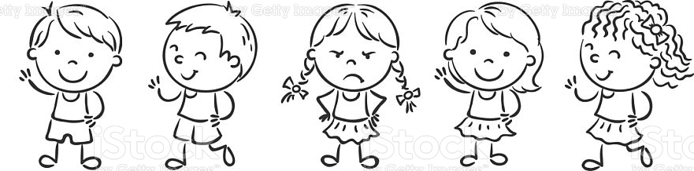
What makes me happy?
What soothes me when I'm sad?
How do I behave when I'm feeling angry?
Things I am really good at?
Things I would like help learning?
What are my Interests?

Slide 3
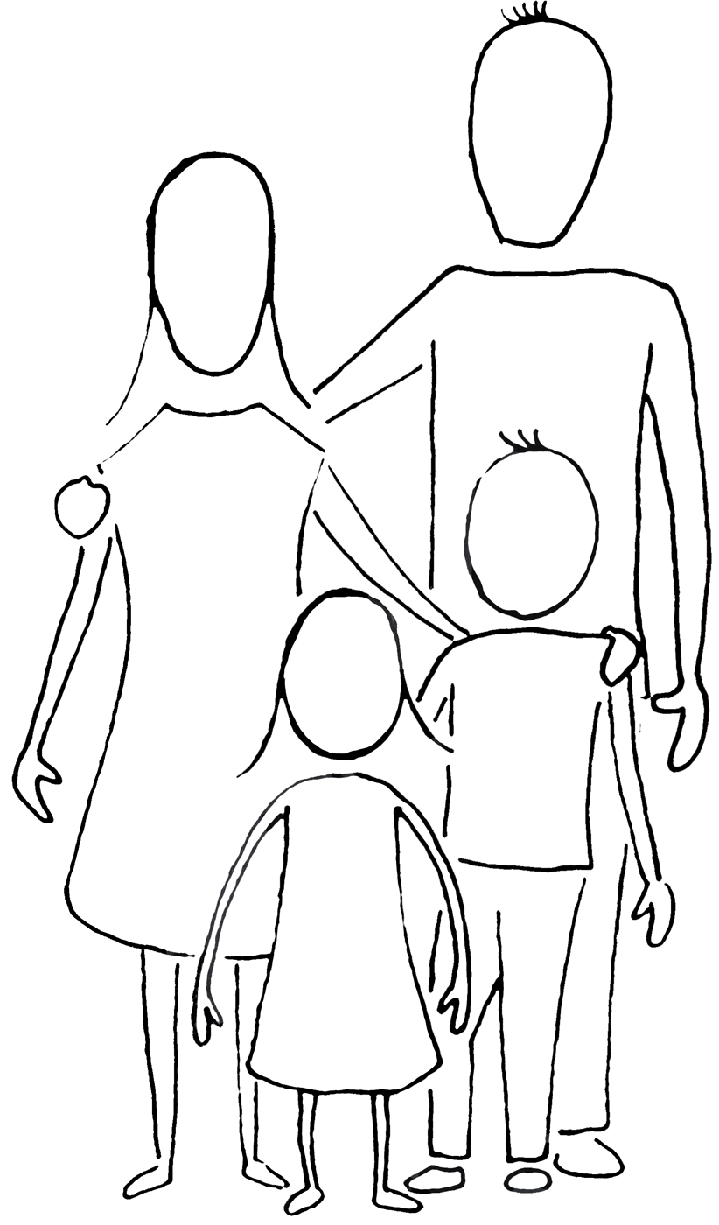


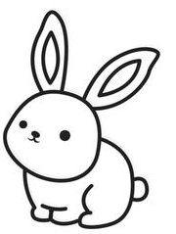

My Family
Who lives in my house :
My Family and I celebrate
(Religious celebrations etc.)
My Golden Rules at Home are?
My pets are?
How do we travel to school?

Slide 4

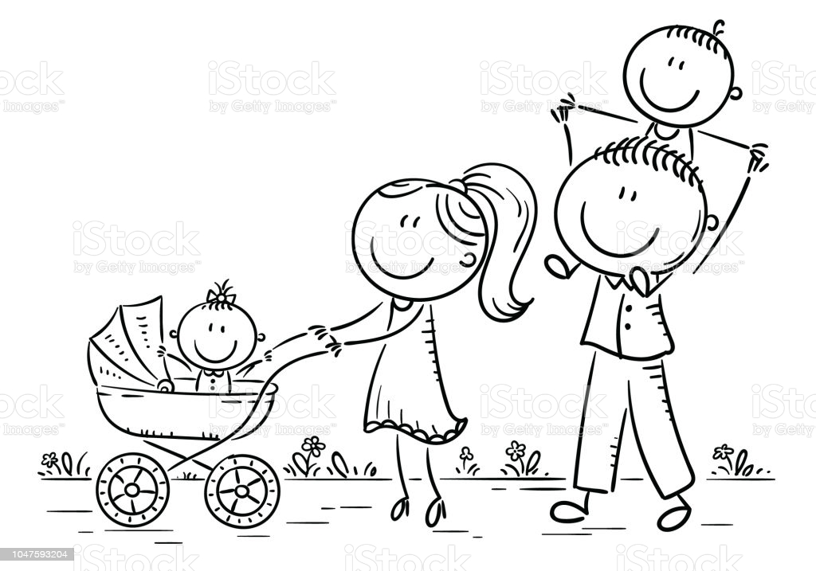
In my community
(Please tick where your child has visited, please comment any experiences)
To a park/Woodland
To the Dentist
To the Doctors/Hospital
To a swimming Centre
To a Religious building
To the Library
Eaten out/Restaurant
On a Bus/Train
To the Supermarket
Farm
What did they enjoy? Learn? Experience?
Are you planning to go anywhere new soon?
(A Museum? Holiday? Family Event? Farm? Or other?)

