Slide 1
The Chelsfield Preschool and Nursery Newsletter April 2025
Happy April
Thank you to all who attended our parents evening. It was a great success and our busiest yet.
Theme for April- Traditional stories
We will be looking at-
Goldilocks and the three bears
Three little pigs
Favourite stories
Creating a Character
We will be celebrating-
St Georges Day
Easter
Dates For April 2025
Preschoolers-
Friday 4th April- Last day of term
Easter break- Monday 7th April until Monday 21st April
Preschool children to return Tuesday 22nd April
Nursery closed to all children 18/04/25 Good Friday and 21/04/25 Easter Monday.
Nursery closed Monday 5th May, Monday 26th May Bank Holiday
Gentle reminders
No shoelaces, skinny jeans, dresses or skirts, please also be aware that vests with poppers are not ideal, if possible, can children wear vests minus these please.
No jewellery to be worn, we have seen an increase in jewellery worn by the children, this can be a Safeguarding concern, and we are unable to be responsible for its safe return.
Please remember to regularly check your child's bag and replace any items used. Ensure sufficient supplies are provided and nappies replaced on a daily basis.
All Nursery children who stay with us for the longer day, please provide a toothbrush and paste to enable us to encourage the children to brush their teeth after tea.
Please check your child's tray on a regular basis to take home any craft they may have made each day.
We would like to raise awareness once again regarding our carpark. Please do not use the carpark after 9am or before 3pm. Children are not to run around and play as this is a major safeguarding concern.
Emergency contacts
We do not appear to have received a third emergency contact for any child, please provide this as soon as possible.
Warm Weather notices
As the weather begins to change, for all children who bring along a packed lunch, please ensure you provide an icepack inside their lunch bag.
Sun cream will also be required, please label this with your child's name.
Books going home
Please return your child’s book each week, your children enjoy choosing their new book each week and can become upset if they do not bring along their book bag.
New toilet training guidance:
Please see the link below.
https://edua-zcmp.maillist-manage.eu/click/195f6ae4daee87a/195f6ae4dae5a65
We would like to wish you all a Happy Easter and hope you all enjoy your break.
Please look at our new celebration part of our newsletter which will showcase what the children celebrate and learn every month
You can contact us on Phone - 01689853183
Email - Chelsfieldbrom@yahoo.co.uk

Slide 2
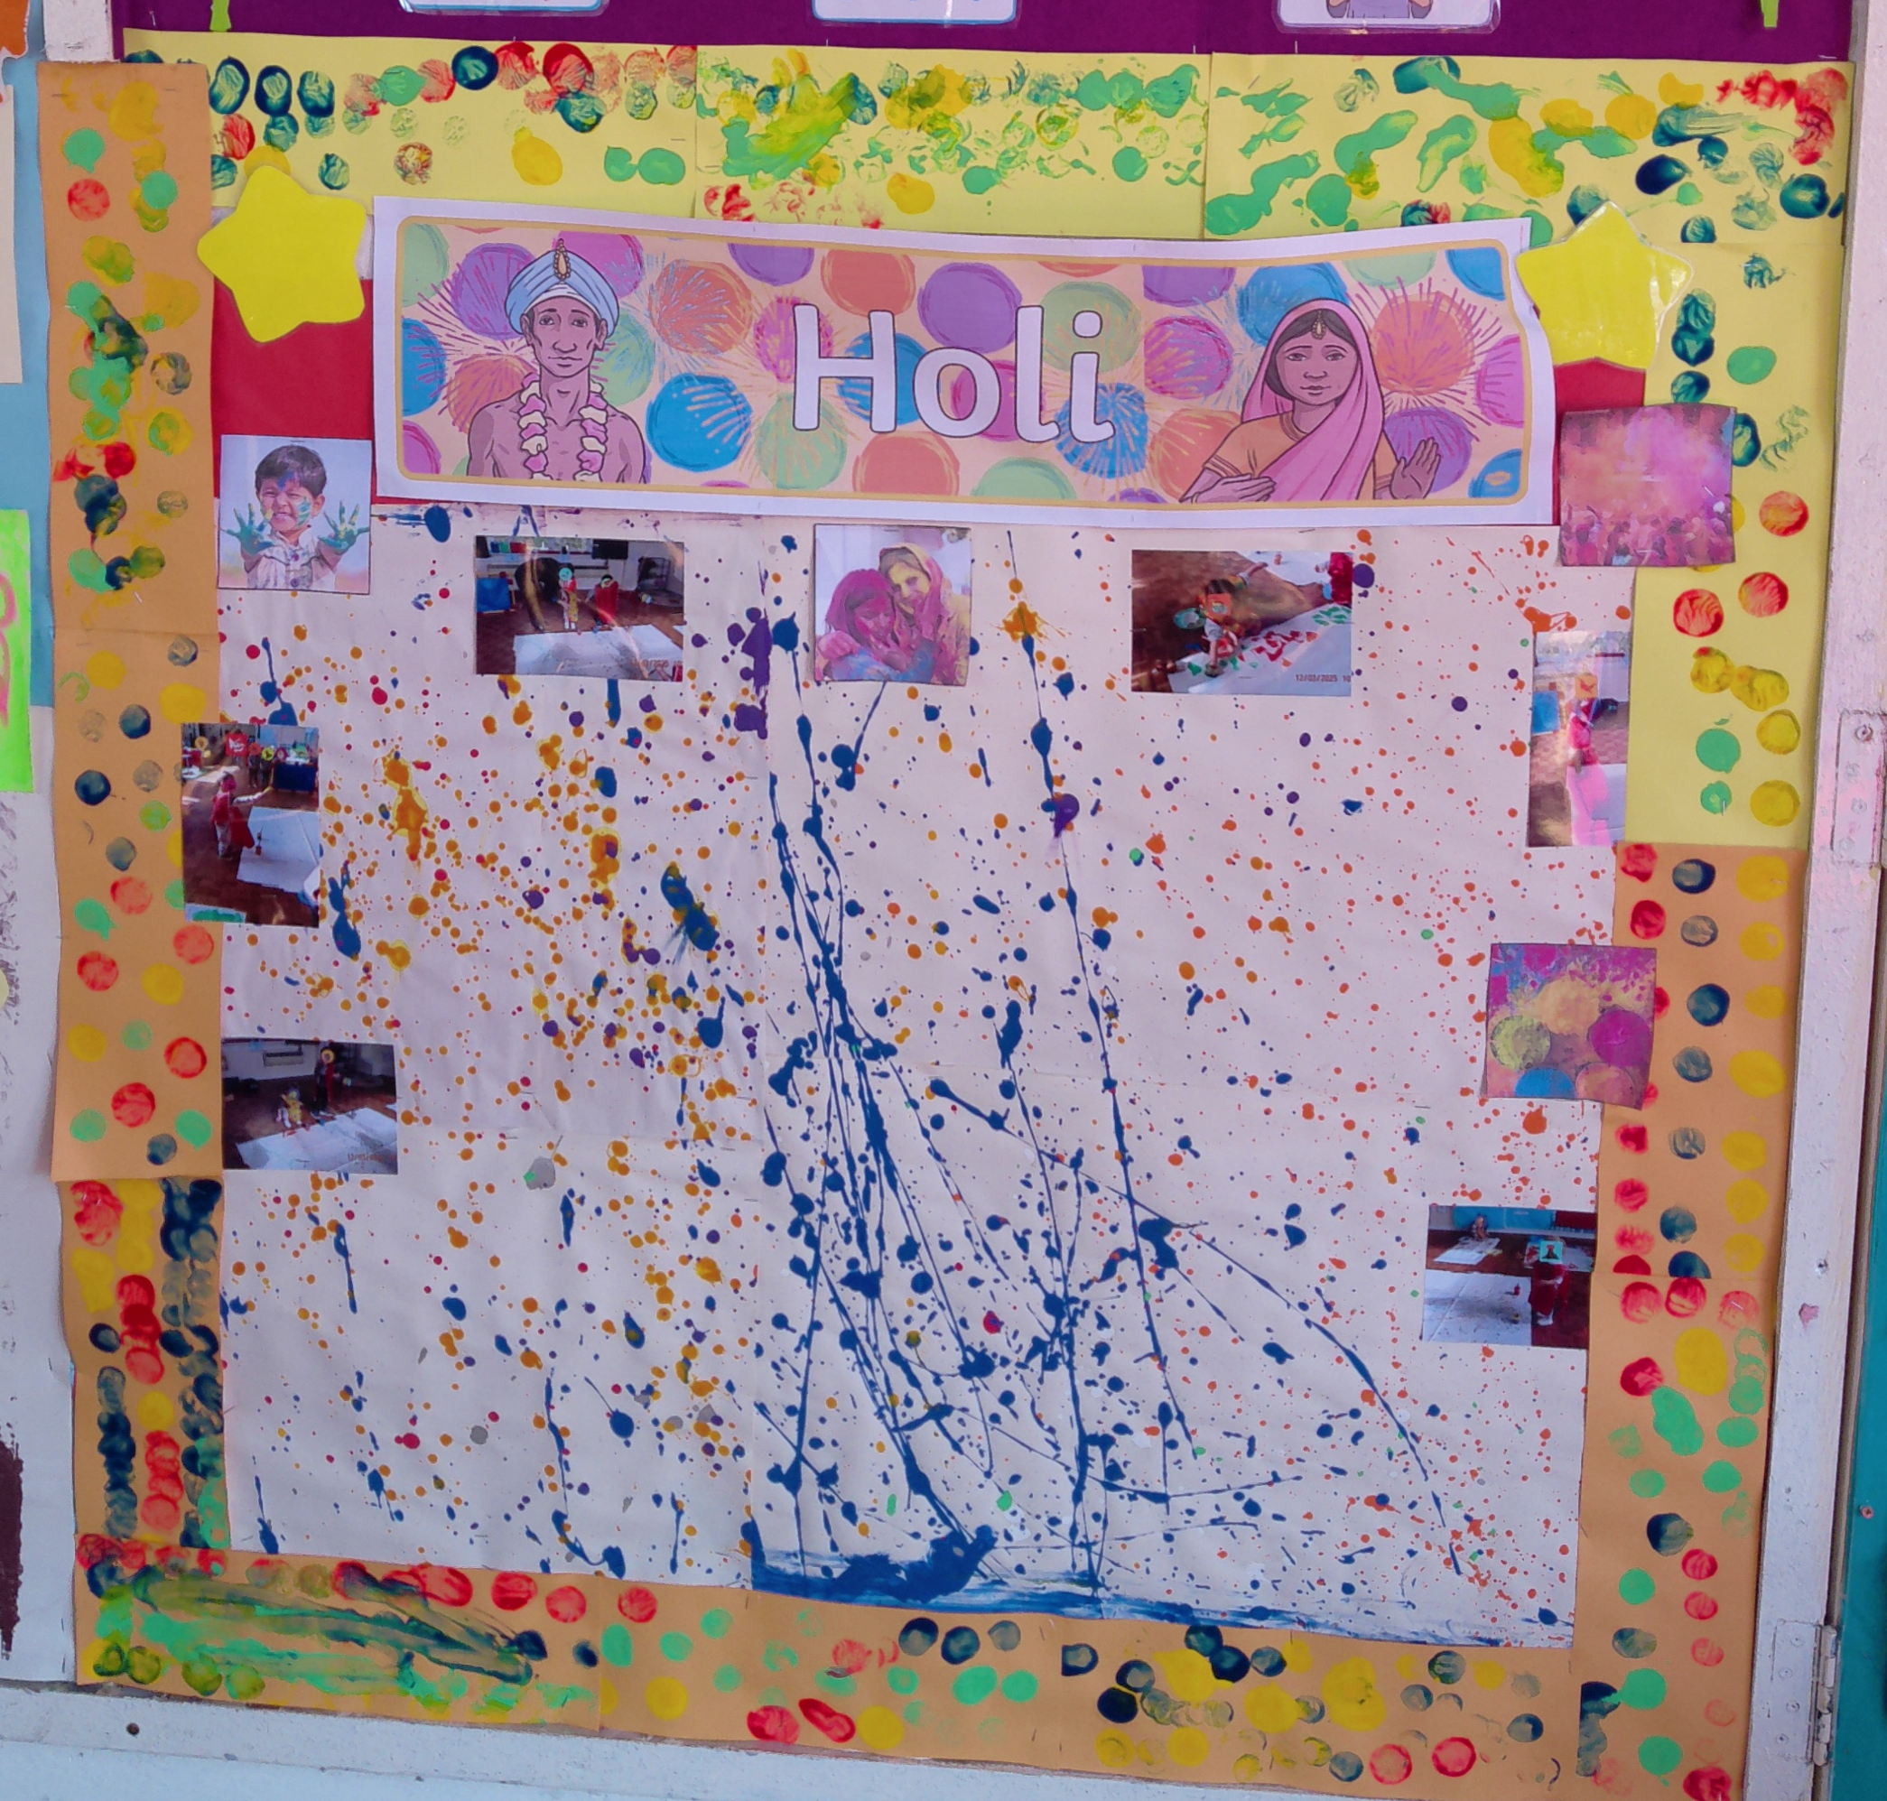
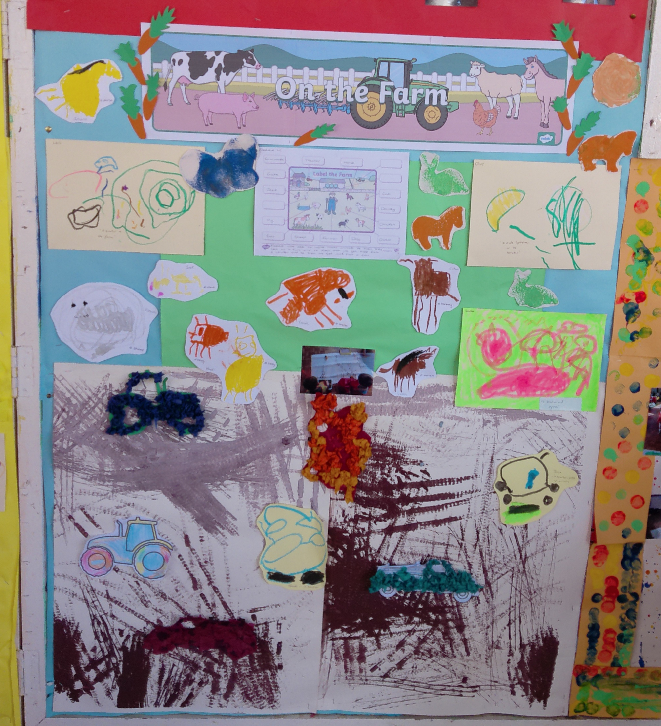
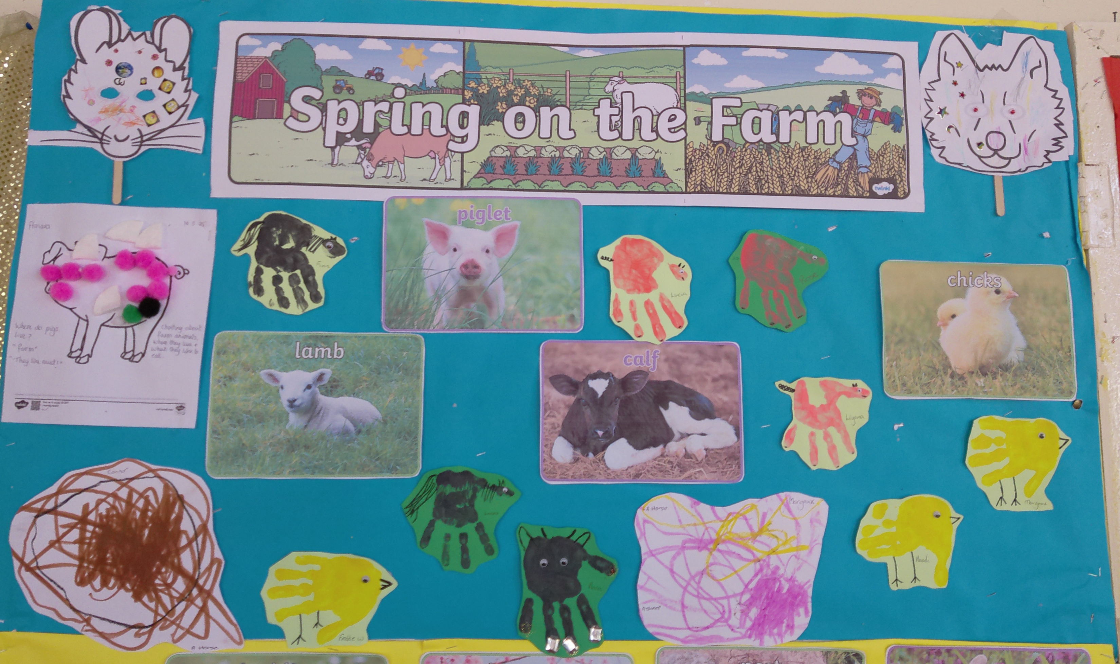
Celebration Page March 2025
Please enjoy a look at what the children learnt and celebrated during March 2025
The Children Created Tractor tracks using toy tractors to help learn about working on the farm.
The Children created a picture using splatter paints to celebrate Holi the festival of Colour.
The children spoke about what produce
the farm provides and why a framer would have a scarecrow in their fields.
The children learnt about the new life on the farm during springtime and how to recognise farm animal noises. They also made handprint baby animals.
You can contact us on Phone - 01689853183
Email - Chelsfieldbrom@yahoo.co.uk

Slide 3
The Chelsfield Preschool and Nursery Newsletter April 2025
You can contact us on; Phone- 01689853183
Email- Chelsfieldbrom@yahoo.co.uk
NSPCC Helpline
Phone: 0808 800 500
Email: help@nspcc.org,uk
National Domestic Abuse Helpline
Phone: 0808 2000 247
Website: www.nationaldahelpline.org.uk
Bromley and Croydon Women’s Aid (BCWA)
Phone: 020 8313 9303
Email: info@bcwa.org.uk
Website: www.bcwa.org.uk
Bromley Fostering Team
Phone: 020 8461 7701
Email: fostering@bromley.gov.uk
IASS Bromley
Phone: 020 8461 7630
Email: iass@bromley.gov.uk
Local Family Centres
Blenheim Children and Family Centre
Email –BLENHEIMCFC@BROMLEY.GOV.UK
Phone – 01689 831193
Cotmandene Family Centre
Email – COTMANDENECFC@BROMLEY.GOV.UK
Phone – 0208 300 2548
Children and Family Centres offer a range of services to meet the needs of children under five and support their families.
Bromley SEND parents have your say!
We are an independent group of parents and carers who work in partnership with education and health to influence the development of services provided for your child.
https://bromleypcf.co.uk/

